Slide 1
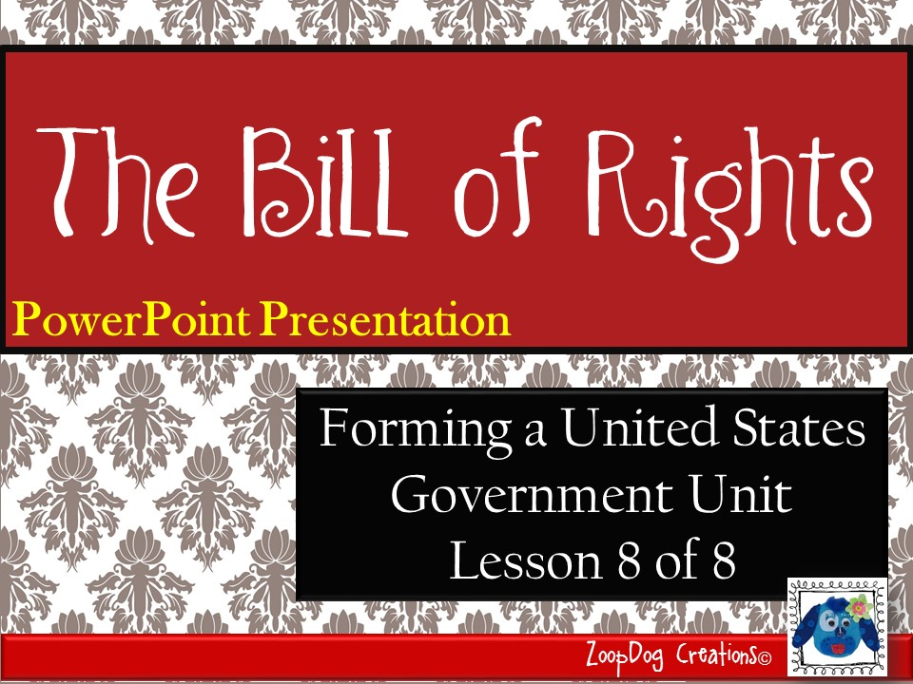

Slide 2
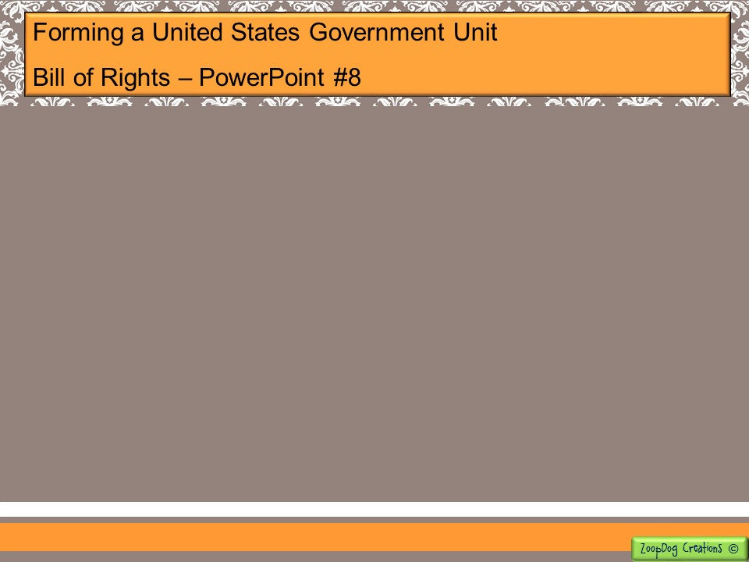
VOCABULARY Bill of Rights – Amend – Due process – Self-incriminating testimony – Natural Rights – Posterity – Preamble –

Slide 3
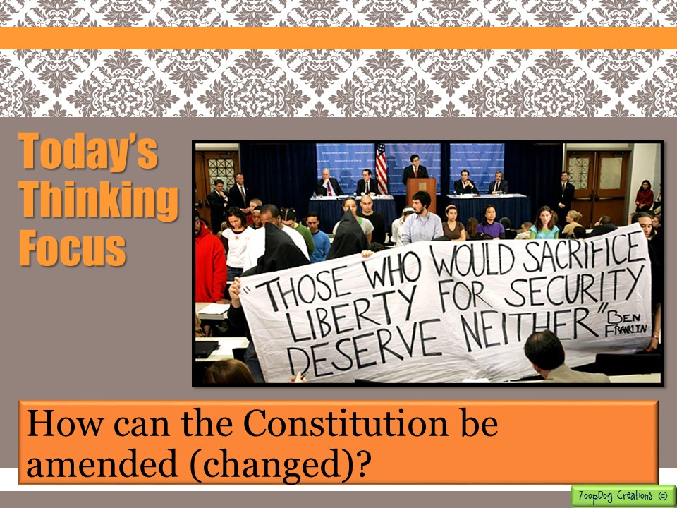

Slide 4

And the story continues . . .
The Virginia and New Jersey Plans are created.
The Great Compromise created by Roger Sherman finally settles the dispute.
Northern and southern states begin fighting over slavery. The Three-Fifths Compromise allows slaves to be counted as 3/5th of a person.
The Founding Fathers took ideas from the Magna Carta, Locke, Montesquieu, the Mayflower Compact and others to create the U.S. Constitution.
Federalists and Anti-Federalists debate the need for a Bill of Rights. The thirteen states ratify the U.S. Constitution with the promise of a Bill of Rights to be included.

Slide 5
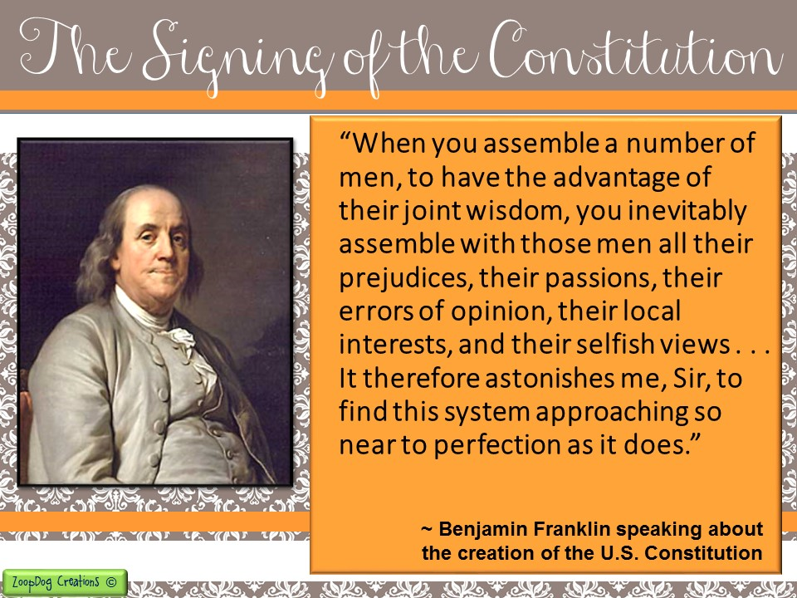

Slide 6
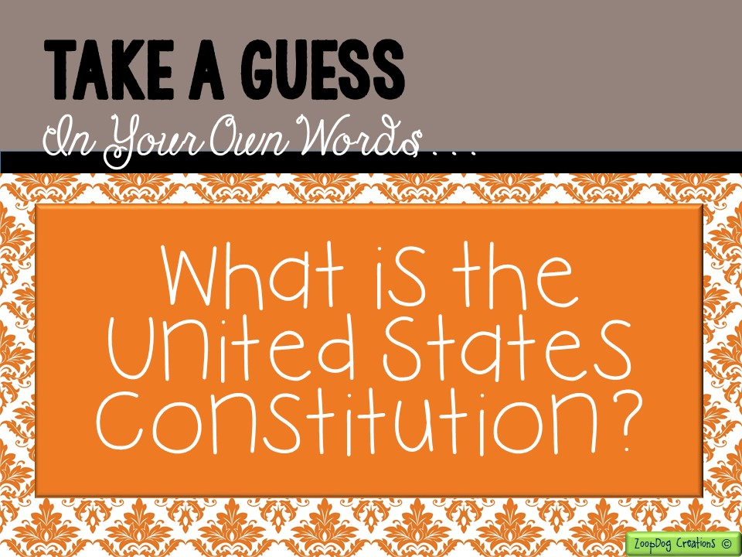

Slide 7
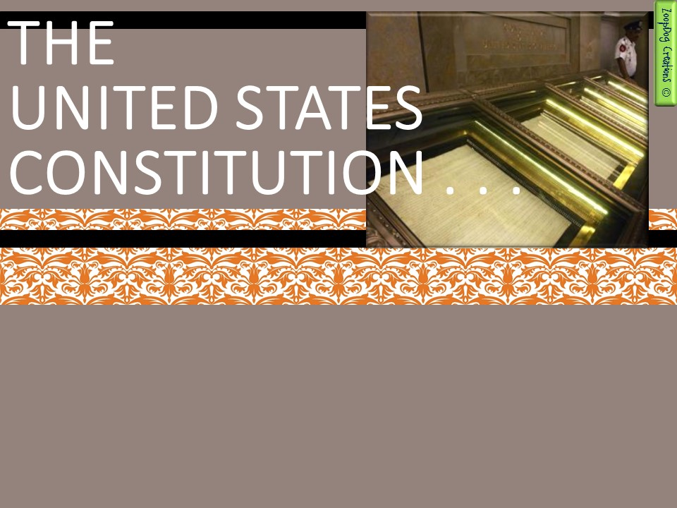
Protects the rights of the citizens of the United States.
Is a framework for the government.
Contains the Bill of Rights (the first 10 amendments) outlining American citizens’ freedoms.
Is an “instruction manual” for how the government
is to be run.
Ensures citizens’ liberties and freedoms!

Slide 8
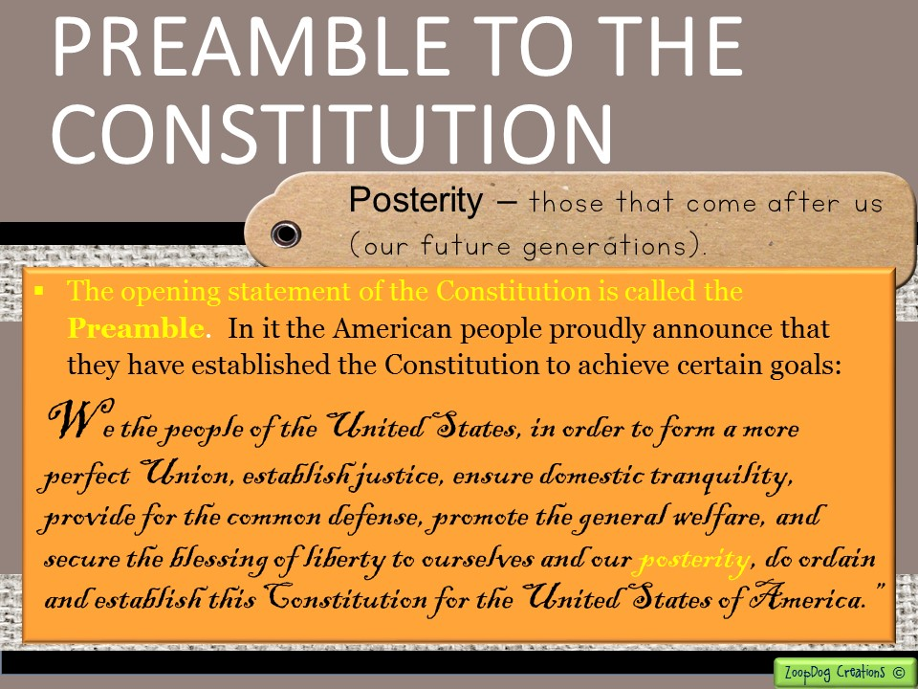

Slide 9
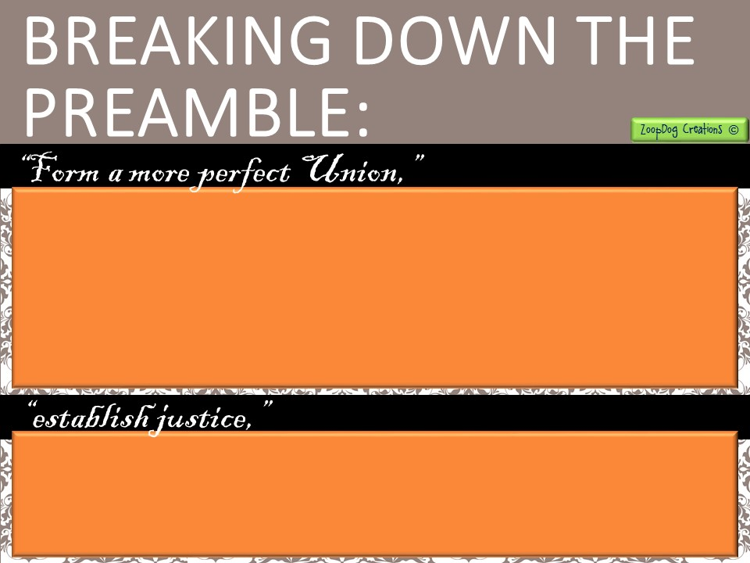
Under the articles of Confederation, the United States was a loose alliance of independent, quarreling states.
Many states acted like separate nations.
One of the main goals of the framers of the Constitution was to get the states to work together as part of a single, united nation.
Justice means that the laws of the land be applied fairly to every American regardless of that person’s race, religion, gender, country of origin, political beliefs or financial situation.

Slide 10

That the government will provide peace at home whether it means using the FBI to solve a crime or calling out the National Guard during times of unrest.
The President can summon such aid if a state or community cannot or will not respond to the emergency.
After the American Revolution, the United States had no armed forces to defend itself. The Constitution gives Congress the power to “raise and support armies,” and to “provide and maintain a Navy” to protect its borders.

Slide 11

The government is to provide an environment for the well-being of all the people.
The national government has the power to collect taxes and set aside money for programs that will benefit the people.
For instance the government supports scientific research and development to improve the quality of life, school nutrition programs, college tuition programs, social security, safety standards, etc.
Liberty is the freedom to live as you please, as long as you obey the laws and respect the rights of others.

Slide 12
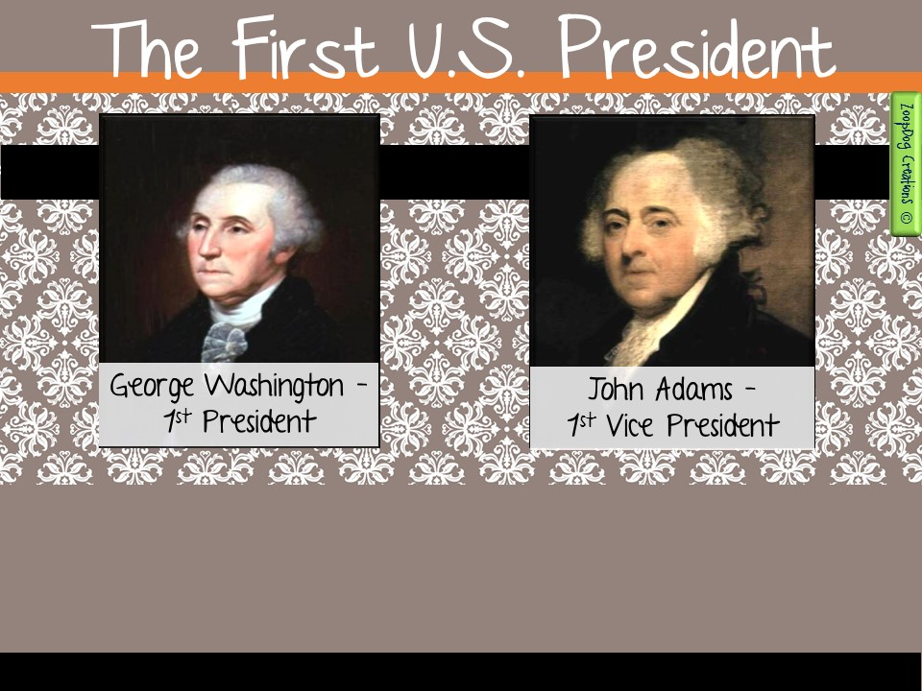
Americans voted in the first election under the Constitution in 1789.
It was no surprise when George Washington was elected President, while John Adams was chosen Vice President.

Slide 13
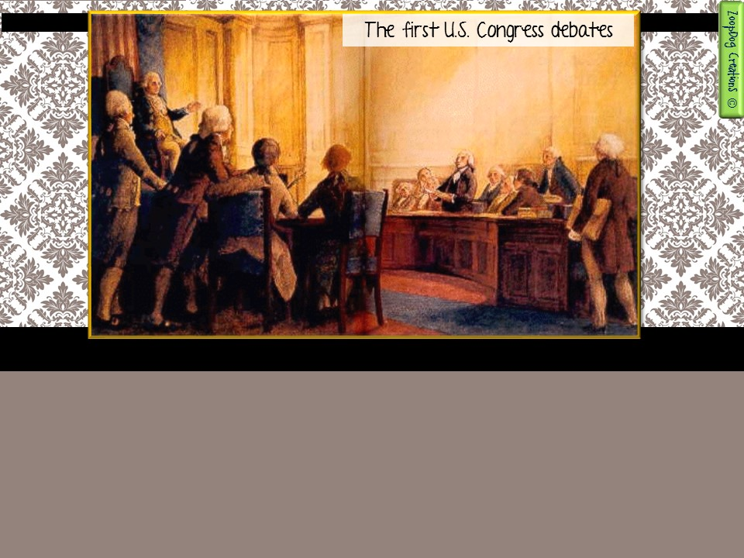
The first Congress was made up of 59 representatives and 27 senators.
They met in New York City, which was chosen as the nations first capital.
The first Congress quickly turned its attention to adding a Bill of Rights – the first ten amendments to the Constitution.

Slide 14
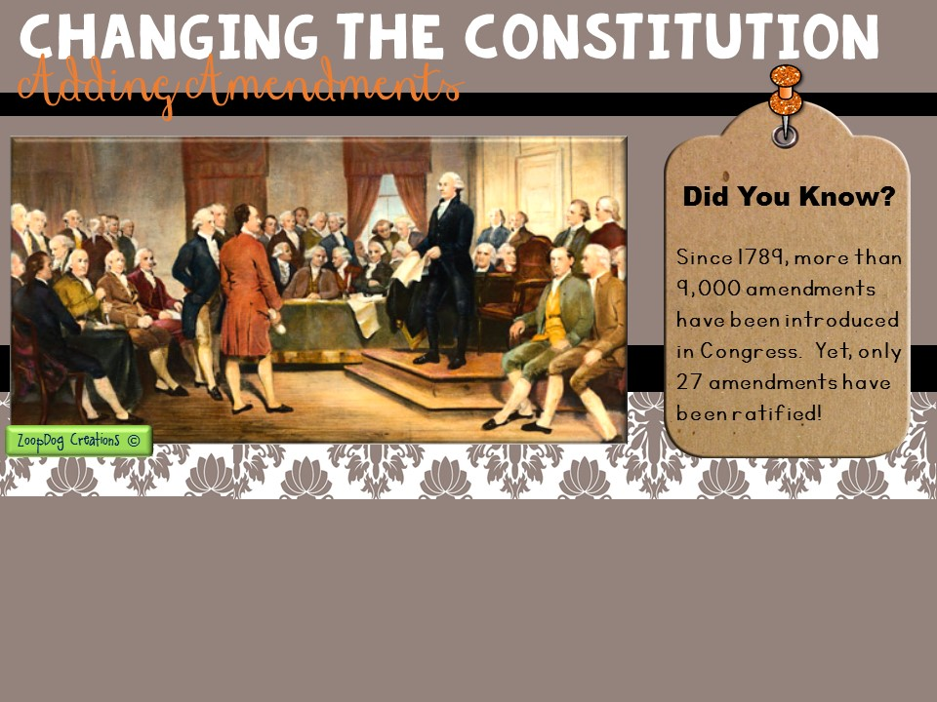
The Founding Fathers had set up a way to amend (change) the Constitution. But they did not want people to make changes lightly.
Thus, they made the process of amending the Constitution fairly difficult.

Slide 15
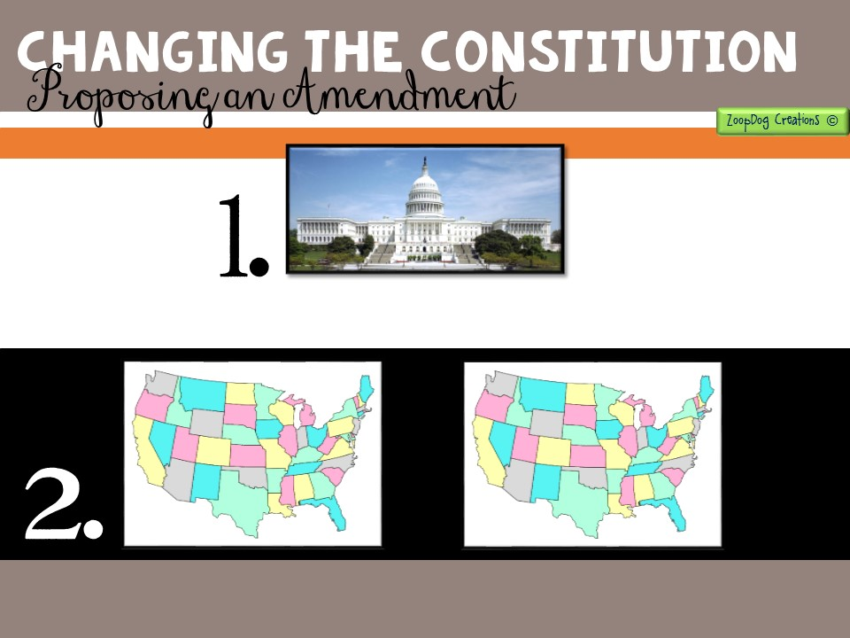
2/3
Two-thirds (2/3) of both houses of Congress can vote to propose an amendment.
2/3
3/4
The amendment must then be ratified.
2/3 of the states can request special conventions to propose amendments.
Three-fourths (3/4) of the states must approve the amendment before it can become part of the Constitution.

Slide 16

In more than 200 years since the Constitution was adopted, only twenty-seven (27) amendments have been approved.
Ten of those amendments were added in the first years after the Constitution was ratified!
The first Congress proposed a series of amendments to the Constitution in 1789.
By December 1791, three-fourths (3/4) of the states had ratified 10 amendments. Those amendments became known as the Bill of Rights.

Slide 17
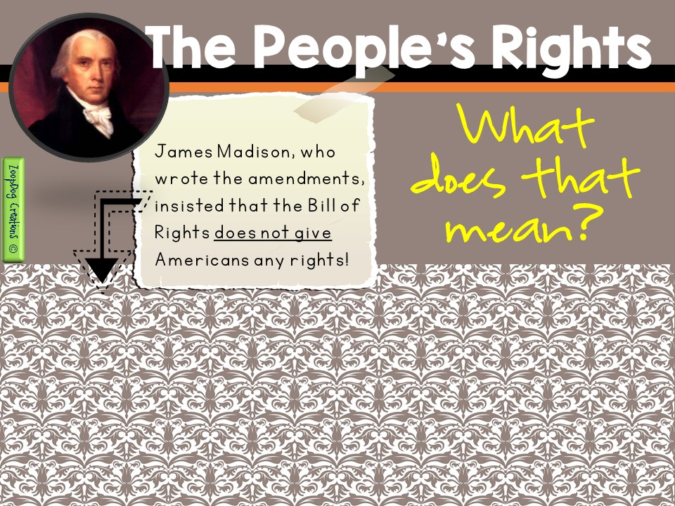
People already have the rights listed in the amendments simply because they are born.
They are “natural rights,” said Madison, that belong to all human beings from birth.
The Bill of Rights simply prevents the government from taking these rights away.

Slide 18

The first ten amendments that make up the Bill of Rights
ensure the basic freedoms of American citizens.
The First Amendment guarantees individual liberties, including freedom of Speech, and freedom of the press (newspaper), freedom of religion.
It also guarantees the right to assemble (meet in a group) peacefully and the right to petition the government.

Slide 19

Free Speech
Say what you like!
Freedom of the press
Write what you like!
Freedom to Assemble
Gather where you like!

Slide 20
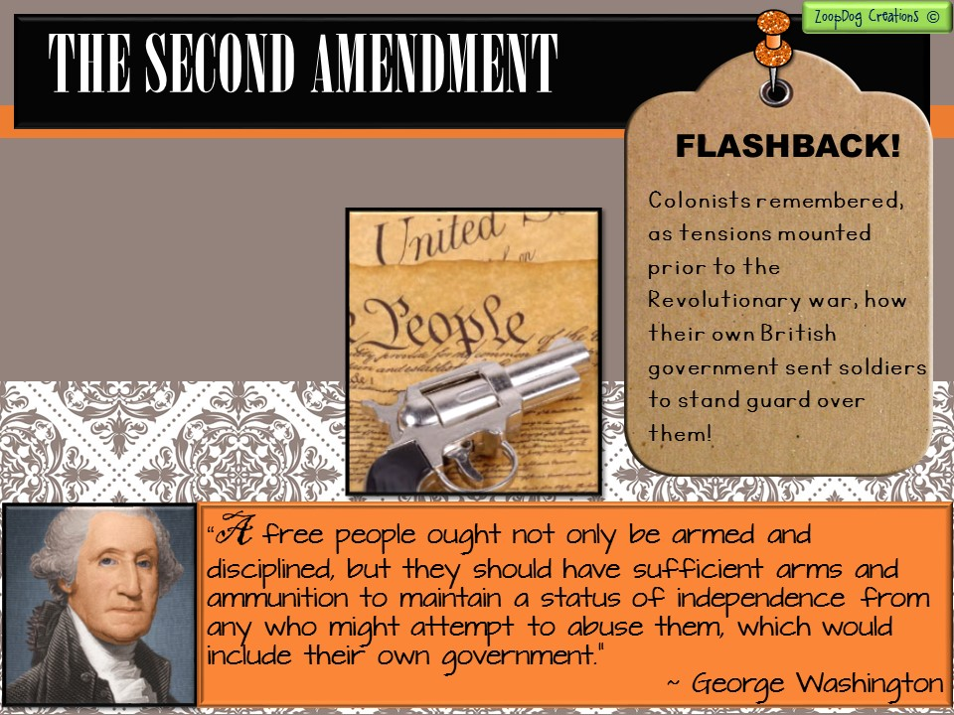
This amendment was created because of the colonists’ struggle with Britain.
The Second Amendment guarantees citizens the right to keep and bear arms (guns).

Slide 21
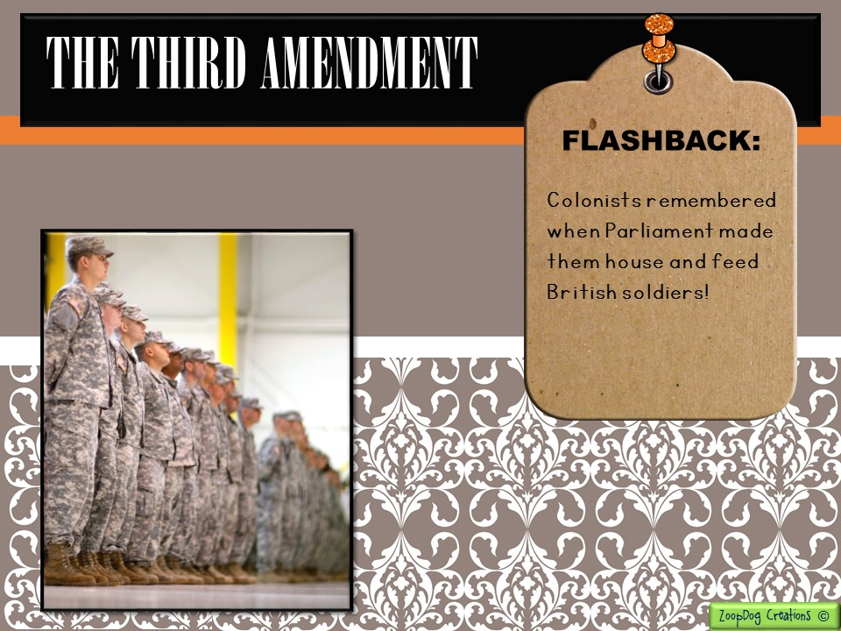
This amendment was created because of the colonists’ struggle with Britain.
The Third Amendment prevents Congress from forcing citizens to quarter (house) troops in their homes.

Slide 22
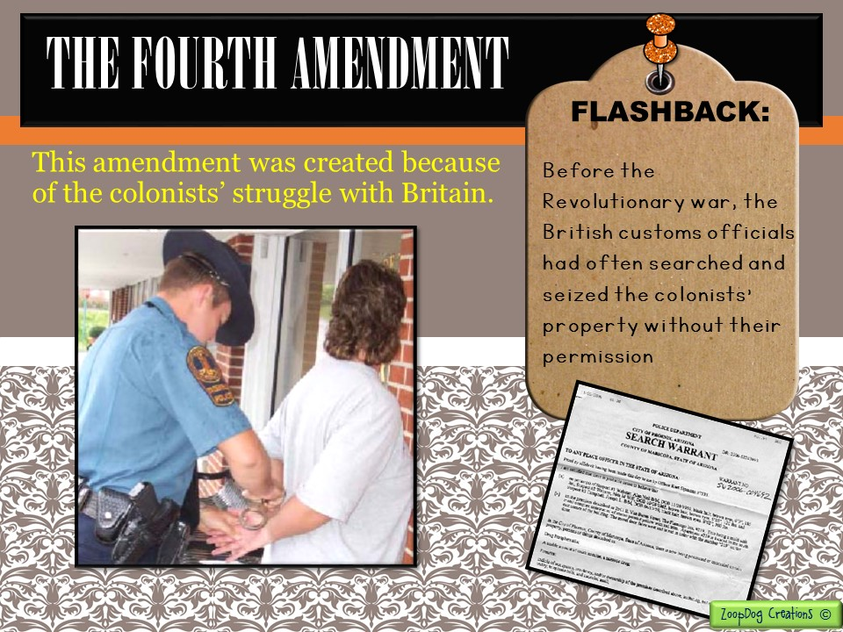
The Fourth Amendment protects citizens from unreasonable search and seizure.

Slide 23

Does the United States government have the right to:
Tap your phone calls?
Put video surveillance cameras on the streets?
Watch what sites you go to on the internet?

Slide 24
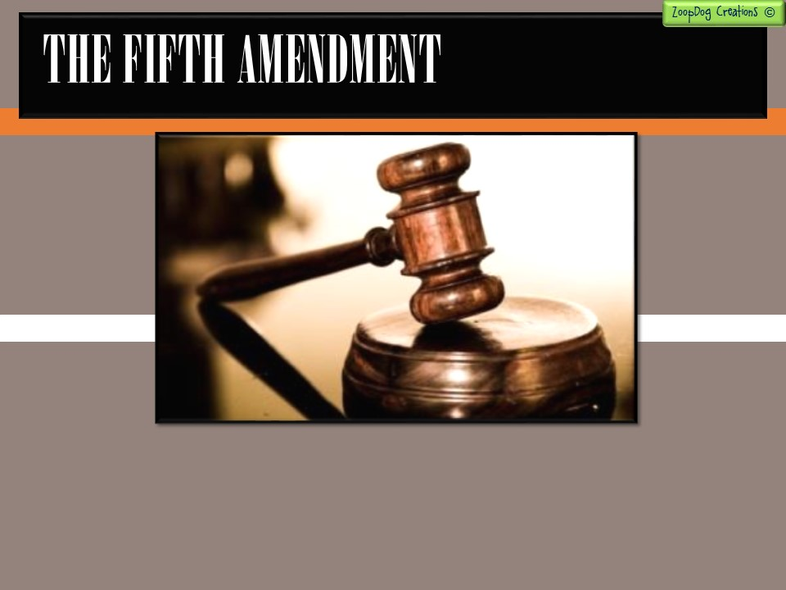
The Fifth Amendment guarantees due process of law.
Due process means that the government must follow the same fair rules in all cases brought to trial.
Under the Fifth Amendment, the accused must be notified of the charges brought against him or her.

Slide 25
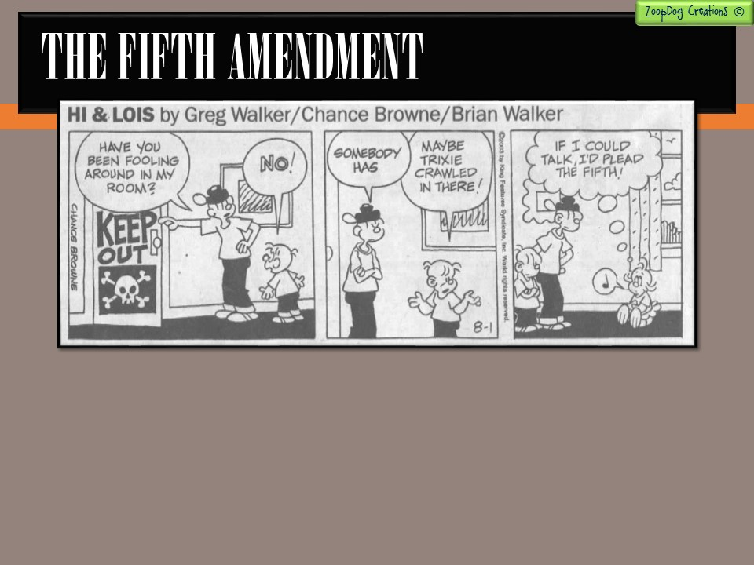
The accused must also be given the chance to present a defense in court (to be able to say their side of the story).
Also, the government cannot require self-incriminating testimony (you don’t have to say anything that could be used against you) nor may a defendant be tried twice for the same crime if the defendant has already been acquitted (let off).

Slide 26
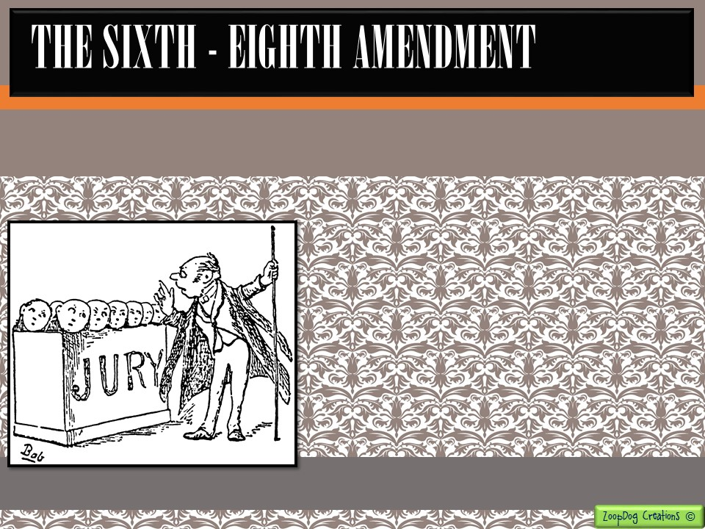
The Sixth through Eighth amendments provides other protections for citizens accused of crimes.
The Sixth Amendment guarantees a jury trial in criminal cased and the right to be defended by a lawyer.
The Seventh Amendment requires jury trials in civil cases.
The Eighth Amendment prevents judges from ordering “excessive bail” on a convicted criminal.

Slide 27
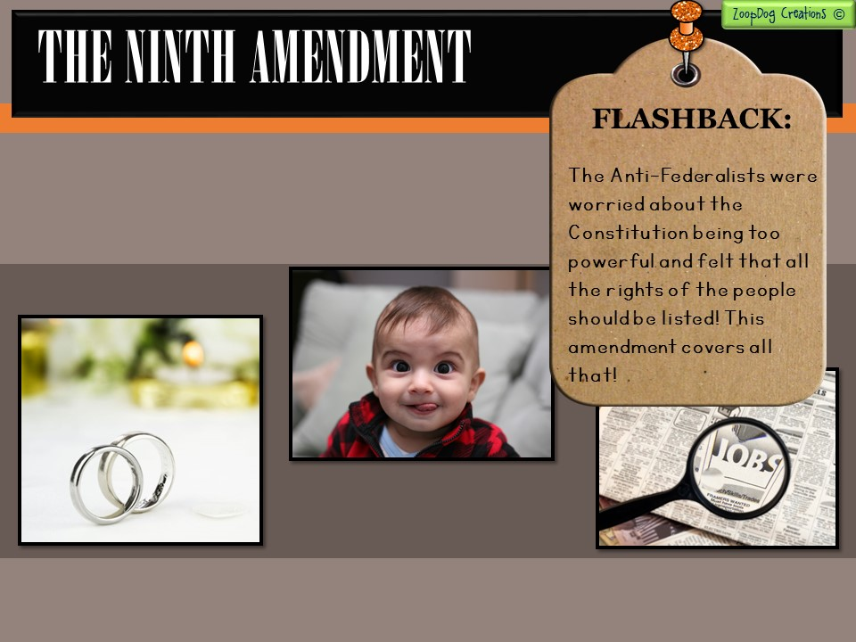
The Ninth Amendment assures that the rights listed in the Constitution are not the only ones that exist.
You have the right to have children.
You have the right to get married.
You have the right to get a job.

Slide 28
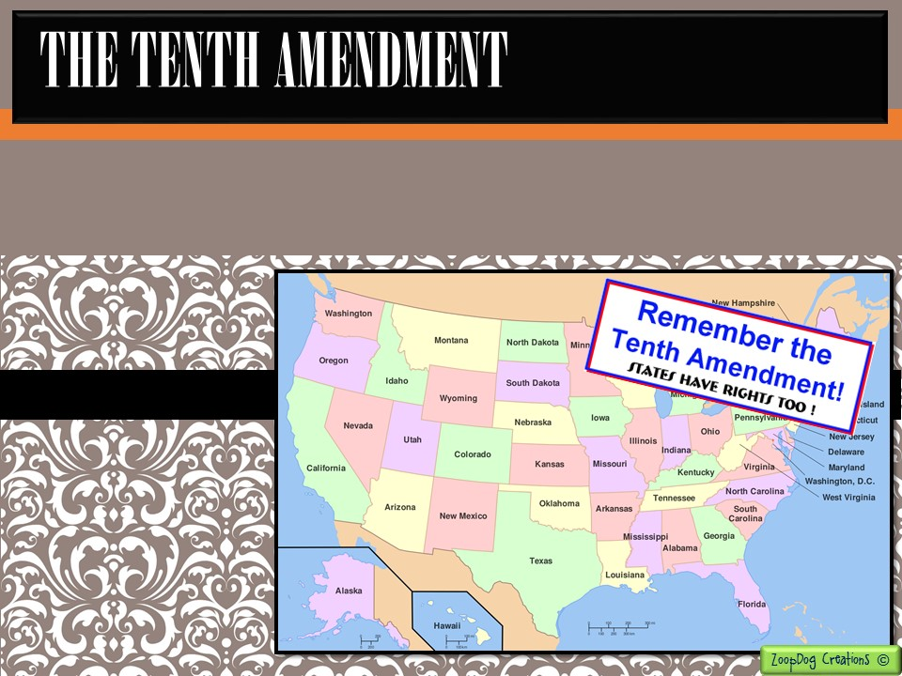
The Tenth Amendment says that all powers not given to the national government and not denied the states are reserved for the states or for the people.
The Tenth Amendment assures that the power of the national government is limited.

Slide 29
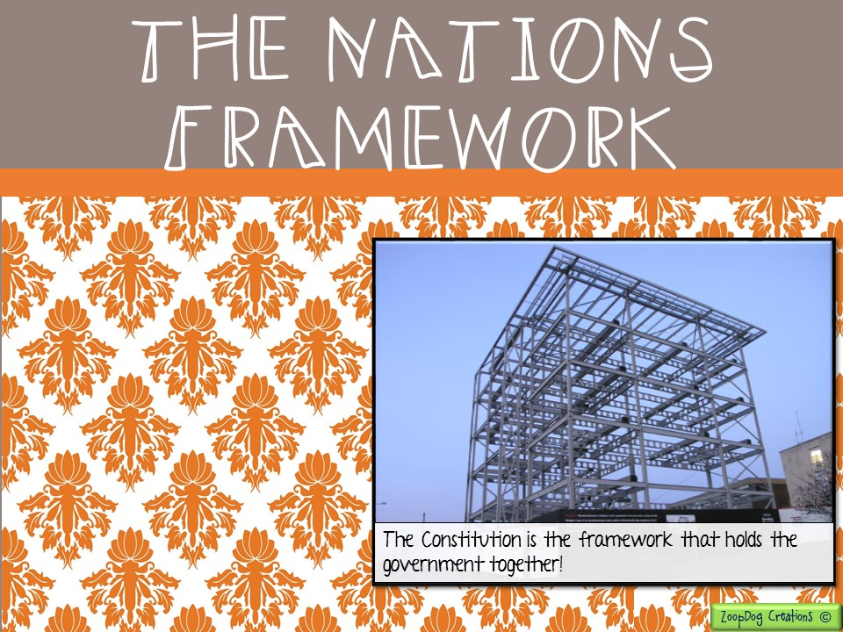
The new framework for the United States government was complete with the Bill of Rights in place.
Today, as the nation continues to evolve, the Constitution remains a living document that changes with the nation.

Slide 30
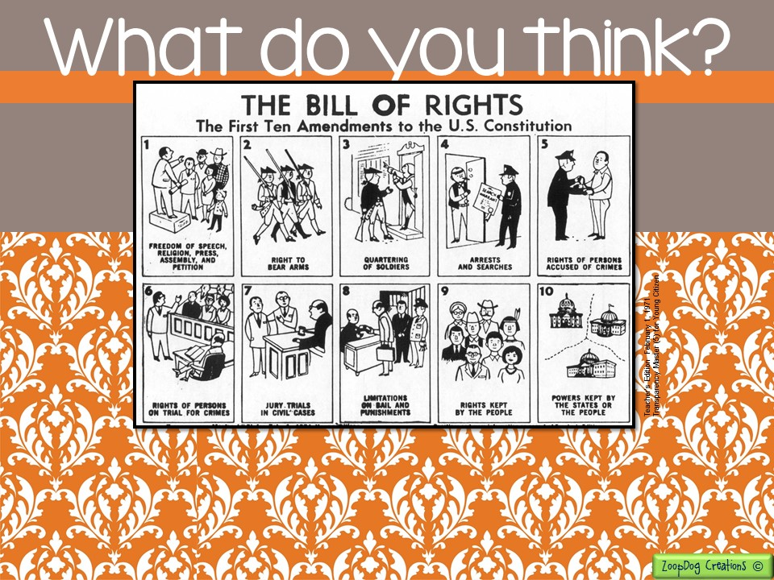
What amendment do you think is the most important? Why?
Without this amendment . . .

Slide 32


Slide 33


